Slide 1

Knowledge Discovery and Management
Tech Champs
Jakkepalli, Rama Charan Pavan (8)
Puthana, Sujitha (24)
Yalamanchili, Sowmya (30)
Nandanamudi, Sreelakshmi (17)

Slide 2
Objective

Slide 3













Dataset
Visualization
Query

Slide 4
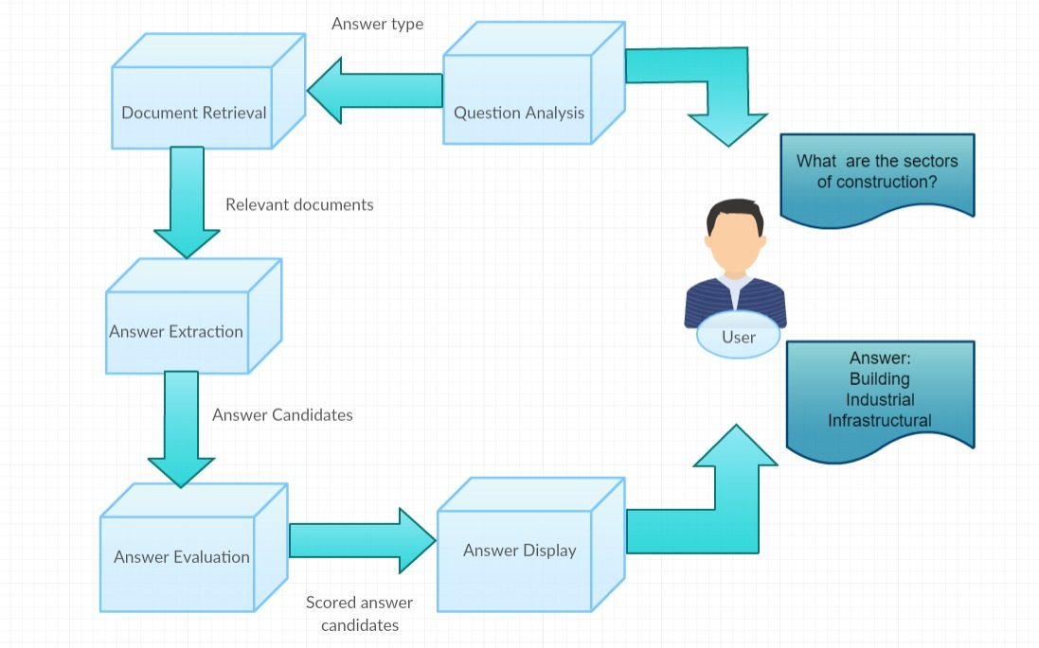
Workflow of Q A System

Slide 5
This work was done in partial fulfillment of the requirements of CS5560: Knowledge Discovery and Management, CSEE Department, University of Missouri –Kansas City (Summer 2017).
Instructors:
Dr. Yugyung Lee,
Mayanka Chandra Shekar,
TAs:
Vijaya Kumari Yeruva,
Saria Goudarzvand.

Slide 6
Thank You

